Slide 1

Data Structures and Algorithms
Trainers: Muhammad Zohad Ijaz, Mariam Ashraf
Moderators: Noor Fatima, Muhammad Zargham Khan

Slide 2

01
Intro to Data Structures

Slide 3

What are Data Structures?
(Data Structures and Algorithms) is the study of organizing data efficiently using data structures like arrays, stacks, and trees, paired with step-by-step procedures (or algorithms) to solve problems effectively. Data structures manage how data is stored and accessed, while algorithms focus on processing this data.

Slide 4
Importance in Programming
Data structures are foundational to computer science and programming. They make data management easier and more efficient, allowing us to perform operations like searching, sorting, and modifying data effectively. When you use the right data structure, you can optimize resource usage and improve performance.
Learning DSA boosts your problem-solving abilities and make you a stronger programmer.
DSA is foundation for almost every software like GPS, Search Engines, AI ChatBots, Gaming Apps, Databases, Web Applications, etc
Top Companies like Google, Microsoft, Amazon, Apple, Meta and many other heavily focus on DSA in interviews.

Slide 5

02
Types of Data Structures

Slide 6
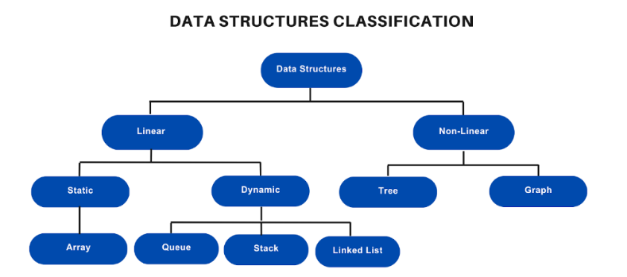
Data structures are the fundamental building blocks of computer programming. They define how data is organized, stored, and manipulated within a program. Understanding data structures is very important for developing efficient and effective algorithms.

Slide 7
Data Structures
Linear data structures are organized in a sequential manner. This means that elements are arranged one after another. Common examples include arrays and linked lists. They allow for simple data retrieval but can be less efficient in terms of certain operations compared to other types.
Static data structure has a fixed memory size. It is easier to access the elements in a static data structure. Example: array.
In dynamic data structure, the size is not fixed. It can be randomly updated during the runtime which may be considered efficient concerning the memory (space) complexity of the code.
Example: Queue, Stack, etc.
Non-linear data structures allow for more complex relationships between elements. Instead of having a straight sequence, elements can have multiple connections. Examples include trees and graphs. These structures are essential for representing hierarchical data or networks, giving us flexibility in data representation.

Slide 8

03
Common Data Structures

Slide 9
Data Structures
Arrays and lists are basic data structures that store collections of elements. An array holds a fixed-size sequence of elements of the same data type, allowing quick access via indexing. Lists, on the other hand, can dynamically grow and shrink, providing more flexibility. Understanding when to use each is important for efficient data handling.
Stacks and queues are linear data structures that manage data in specific orders. A stack follows the Last In, First Out (LIFO) principle, where the last added item is the first to be removed. In contrast, a queue operates on a First In, First Out (FIFO) basis, where the first item added is the first one to be removed. These structures are essential for tasks like function calls and managing resources.

Slide 10

Trees and Graphs
Trees and graphs are powerful data structures used for representing hierarchical and interconnected data. A tree structure consists of nodes with a hierarchy, where each node can have multiple children but only one parent. Graphs consist of nodes connected by edges and can describe complex relationships. Understanding these structures is key for creating efficient algorithms and data representations.

Slide 11

04
Algorithms Overview

Slide 12
What are Algorithms?
Algorithms are step-by-step procedures or formulas for solving problems or performing tasks. They are essential in computer science for data processing and computations. From simple addition to complex sorting tasks, understanding how algorithms work can help you write more efficient and effective code. Think of them as recipes that outline the process to achieve a specific outcome.
An algorithm is a finite sequence of well-defined instructions that can be used to solve a computational problem. It provides a step-by-step procedure that convert an input into a desired output.
Algorithms typically follow a logical structure:
Input: The algorithm receives input data.
Processing: The algorithm performs a series of operations on the input data.
Output: The algorithm produces the desired output.

Slide 13
Algorithms
Sorting algorithms are designed to arrange the elements of a list or array in a certain order, typically ascending or descending. Common sorting techniques include bubble sort, quicksort, and mergesort. Each algorithm has its own advantages and disadvantages in terms of efficiency and simplicity, and knowing which to use can significantly impact performance.
Searching algorithms are used to locate a specific value within a data structure. Common methods include linear search, which checks each element one by one, and binary search, which efficiently narrows down the search space by dividing the data. Choosing the right searching algorithm is crucial for optimizing performance, especially with large datasets.

Slide 14
Thank you!
Do you have any questions?
Reach me by clicking
zohadijaz786@gmail.com

